Slide 1
Basic Data Analysis
Emanuele Della Valle
Prof. @ Politecnico di Milano
Founder & Partner @ Quantia Consulting
Marco Balduini
Founder & CEO @ Quantia Consulting
Riccardo Tommasini
Prof. @ University of Tartu

Slide 2
Introduction

Slide 3
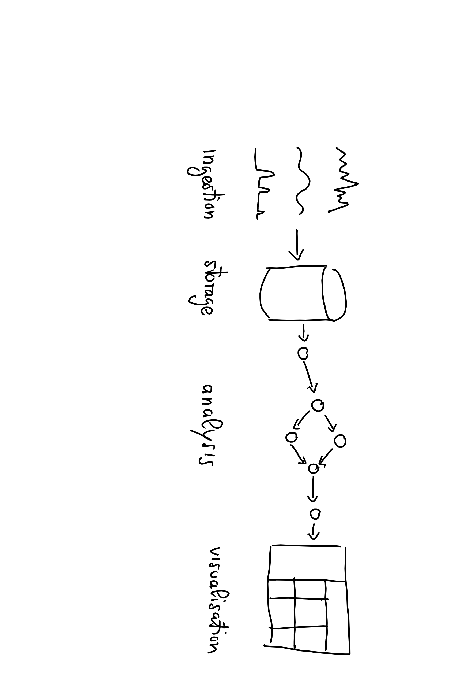
Data Lifecycle

Slide 4

Data Lifecycle

Slide 6
Why Flux?
I don't want to have to write query code in one language and processing code in another language.
– Paul Dix - CTO InfluxData

Slide 7
What Is Flux?
Flux Query Language?
Flux Query Language?
Query + Process + Act
Flux Data Scripting Language
Notes:
Suggesrico Ask – Process + Act
Cosi da eliminare Query

Slide 8
What Is Flux?
Written to be:
Useable: easy to learn
Readable: developers read more code than we write
Extensible: developers can extend the language
Composable: developers can build onto the language
Testable: queries are code
Contributable: open source contributions matter

Slide 9
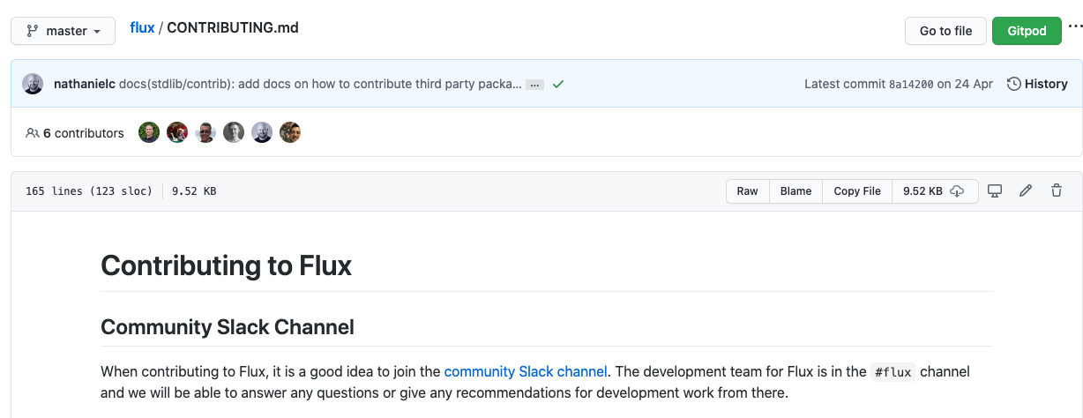
Flux is Open

Slide 10
What is Flux? (cont.)
Open Source (MIT)
Data-first mentality
Streaming Data
Planner-optimized
Compatible with multiple sources and sinks

Slide 11
Exploring Flux Basics

Slide 12
Basic Flux Language Elements
Anatomy of a Flux script:
data source
time range
data filters
Anonymous function
from(bucket:"telegraf/autogen")
|> range(start:-1h)
|> filter(fn: (r) =>
r._measurement == "oven" and
r._field == "temp" and
r._value > 300.0)
Pipe-forward operator: chain operations together

Slide 13
Basic Flux Language Elements
Anatomy of a Flux query:
data source
time range
data filters
parameter(s)
from(bucket:"telegraf/autogen")
|> range(start:-1h)
|> filter(fn: (r) =>
r._measurement == "oven" and
r._field == "temp" and
r._value > 300.0)
expression(s)

Slide 14
Flux Data Model
:o
An infinite stream…
of finite tables…
identified by the GroupKey

Slide 15
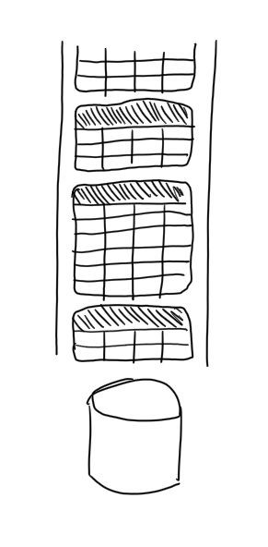
Flux Data Model
An infinite stream…
of finite tables…
identified by the GroupKey

Slide 16
From bucket to tables
_time | _m | host | _field | _value
14…0 | obs | ovenA | humidity | 23
14…2 | obs | ovenA | humidity | 21
GroupKey[obs, ovenA, humidity]
_time | _m | host | _field | _value
14…1 | obs | ovenA | temp | 301
14…3 | obs | ovenA | temp | 303
GroupKey[obs, ovenA, temp]
_time | _m | host | _field | _value
14…1 | obs | ovenB | temp | 125
14…2 | obs | ovenB | temp | 127
GroupKey[obs, ovenB, temp]
[…]
from(bucket:"telegraf/autogen")
|> range(start:-1s)
_time
_m
host
temp
humidity
14…0
obs
ovenA
301
23
…
…
…
…
…
14…1
obs
ovenB
125
75
_m = _measurement

Slide 17
Query Process
:o
For Each Table:
Convert incoming rows into 0 or more outgoing rows
Map outgoing rows to tables

Slide 18
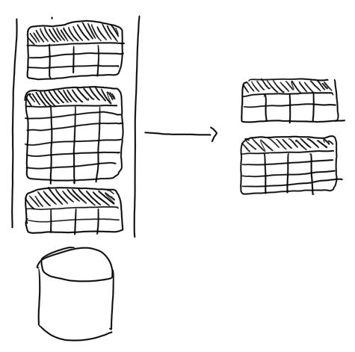
Query Process
For Each Table:
Convert incoming rows into 0 or more outgoing rows
Map outgoing rows to tables

Slide 19
_time | _m | host | _field | _value
14…0 | obs | ovenA | humidity | 23
14…2 | obs | ovenA | humidity | 21
GroupKey[obs, ovenA, humidity]
∅
|> filter(fn: (r) =>
r._measurement == »obs" and
r._field == "temp" and
(r._value >= 303 or
r._vaule <= 125)
_time | _m | host | _field | _value
14…1 | obs | ovenA | temp | 301
14…3 | obs | ovenA | temp | 303
GroupKey[obs, ovenA, temp]
_time | _m | host | _field | _value
14…3 | obs | ovenA | temp | 303
GroupKey[cpu, ovenA, system]
[…]
[…]
_time | _m | host | _field | _value
14…1 | obs | ovenB | temp | 125
GroupKey[cpu, ovenB, system]
_time | _m | host | _field | _value
14…1 | obs | ovenB | temp | 125
14…2 | obs | ovenB | temp | 127
GroupKey[obs, ovenB, temp]

Slide 20
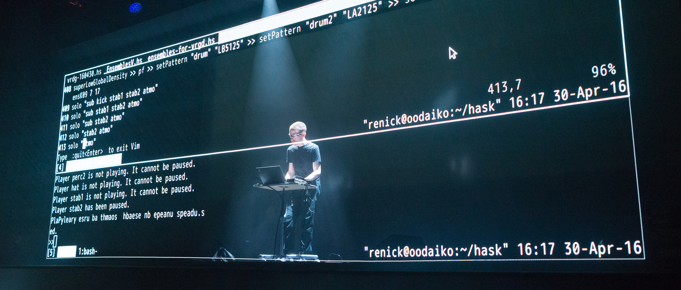
Let’s do some live coding

Slide 21
The Life of a Flux Query
Client
Server
query text
Parser
AST
Evaluator
Query Op-Spec
Procedure Spec
Planner/ Optimizer
Transformation Spec
:)

Slide 22
Quiz
What’s a Bucket?
What’s the Pipe-forward operator |> for?
What’s a result Table in Flux?
What’s a Group Key in Flux?
List of columns for which every row in a table has the same value
A named data source with retention policy
Chains operations
A part of a result

Slide 23
Quiz answer
What’s a Bucket?
What’s the Pipe-forward operator |> for?
What’s a result Table in Flux?
What’s a Group Key in Flux?
[1:B, 2:C, 3:D, 4:A]
List of columns for which every row in a table has the same value
A named data source with retention policy
Chains operations
A part of a result

Slide 24
Exploring flux Windowing

Slide 25

Key concepts
window
Data Sources
Registered Continuous Query
streams of answer
input streams
E. Della Valle

Slide 26
Windows
Streams are infinite in nature
Processing can end only if the input is finite
A window operator selects a finite portion of a stream
Time range is a window operator whose input is a time interval specified either stating an absolute start and end time
range(start: 2019-10-01T00:00:00Z, stop: 2019-10-01T00:05:00Z)
or stating a relative time period relative
range(start:-2h, stop: -1h)
range(start:-1h)

Slide 27

Let’s get dirty!
2

Slide 28
Continuous Linear Pizza Oven
Learning goals:
Data source
Window
Tables
s2
s1

Slide 29
Task
Extract all the measurements in a given range
Absolute: from 2020-10-26T12:00:00Z to 2020-10-26T12:05:00Z
Relative: in the last 24 hours
Take home message
The range() function extracts from the named bucket all the possible tables in the given time range

Slide 30
Let’s get dirty!
3

Slide 31
Continuous Linear Pizza Oven
Learning goals:
Filter by tag
s2
s1

Slide 32
Task
Extract the temperature data from the cooking base area (sensor S1)
Take home message
The filter() function applied to tags selects only the table(s) of your interest from all the possible tables

Slide 33
Let’s get dirty!
4

Slide 34
Continuous Linear Pizza Oven
Learning goals:
Filter by value
s2
s1

Slide 35
Task
Extract the measurements from the cooking base area (sensor S1) with a temperature under 300°
Take home message
The filter() function applied to values selects only the row(s) of your interest from all the possible tables

Slide 36
Exploring flux Shaping and Processing

Slide 37
All Flux Language Elements
Anatomy of a Flux script:
data source
time range
data filters
shaping
processing
from(bucket:"telegraf/autogen")
|> range(start:-1h)
|> filter(fn: (r) =>
r._measurement == "oven" and
r._field == "temp" and
r._value > 300.0)
|> group(columns: ["_field"])
|> mean()

Slide 38
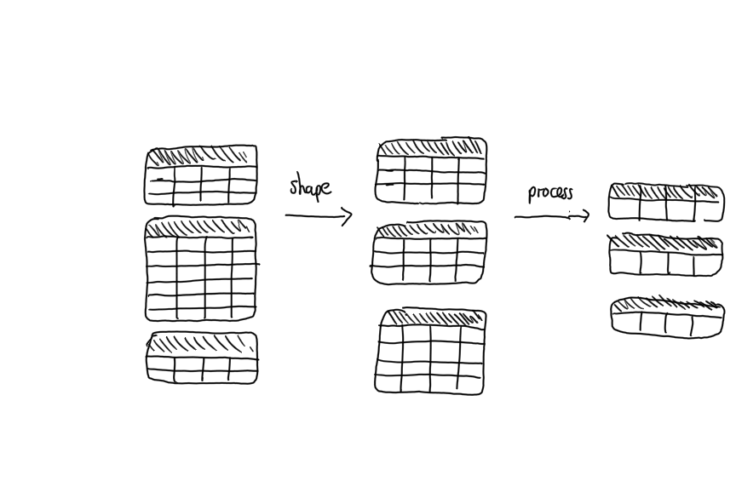

Slide 39
Exploring flux Shaping with group Processing with aggregators and selectors

Slide 40
_time | _m | host | _field | _value
10:45 | obs | ovenA | humidity | 10
11:45 | obs | ovenA | humidity | 20
GroupKey[obs, ovenA, humidity]
_time | _m | host | _field | _value
11:00 | obs | ovenB | humidity | 60
11:30 | obs | ovenB | humidity | 70
GroupKey[obs, ovenB, system]
_time | _m | host | _field | _value
10:45 | obs | ovenA | humidity | 10
11:00 | obs | ovenB | humidity | 60
11:30 | obs | ovenB | humidity | 70
11:45 | obs | ovenA | humidity | 20
GroupKey[humidity]
group(columns: [”_field"])
_time | _m | host | _field | _value
10:35 | obs | ovenA | temp | 300
GroupKey[obs, ovenA, temp]
_time | _m | host | _field | _value
10:35 | obs | ovenA | temp | 300
11:15 | obs | ovenB | temp | 110
11:50 | obs | ovenB | temp | 130
GroupKey[temp]
_time | _m | host | _field | _value
11:15 | obs | ovenB | temp | 110
11:50 | obs | ovenB | temp | 130
GroupKey[obs, ovenB, temp]

Slide 41
Example of aggregator
_time | _m | host | _field | _value
10:45 | obs | ovenA | humidity | 10
11:00 | obs | ovenB | humidity | 60
11:30 | obs | ovenB | humidity | 70
11:45 | obs | ovenA | humidity | 20
GroupKey[humidity]
_field | _value
humidity | 40
GroupKey[humidity]
|> mean()
_time | _m | host | _field | _value
10:35 | obs | ovenA | temp | 300
11:15 | obs | ovenB | temp | 110
11:50 | obs | ovenB | temp | 130
GroupKey[temp]
_field | _value
temp | 180
GroupKey[temp]
NOTE: time, _m and host columns get deleted

Slide 42
Example of selector
_time | _m | host | _field | _value
10:45 | obs | ovenA | humidity | 10
11:00 | obs | ovenB | humidity | 60
11:30 | obs | ovenB | humidity | 70
11:45 | obs | ovenA | humidity | 20
GroupKey[humidity]
_time | _m | host | _field | _value
11:45 | obs | ovenA | humidity | 3000
GroupKey[humidity]
|> last()
_time | _m | host | _field | _value
10:35 | obs | ovenA | temp | 300
11:15 | obs | ovenB | temp | 110
11:50 | obs | ovenB | temp | 130
GroupKey[temp]
_time | _m | host | _field | _value
11:50 | obs | ovenB | temp | 400
GroupKey[temp]

Slide 43
Let’s get dirty!
5

Slide 44
Continuous Linear Pizza Oven
Learning goals:
Function
group()
Aggregates
Selectors
s2
s1

Slide 45
Task
Grouping + Aggregator - Extract the average temperature and the average humidity along the different stages of the linear pizza oven
Selector - Extract the last humidity observation and the last temperature observation from the cooking base area
Take home message
Grouping shape tables
Aggregators (e.g. mean) compress each table in a row
Selectors (e.g. last) select specific row(s) from each table
Notes:
from(bucket: "training")
|> range(start: v.timeRangeStart, stop: v.timeRangeStop)
|> filter(fn: (r) => r._measurement == "iot-oven")
|> group(columns: ["_field"])
|> mean()

Slide 46
Exploring flux Advanced Windowing

Slide 47
Recall
window
Data Sources
Registered Continuous Query
streams of answer
input streams
E. Della Valle

Slide 48
Windows
Streams are infinite in nature
Processing can end only if the input is finite
A window operator selects a finite portion of a stream
We have seen the time range operator
Flux includes a window operator that builds table tumbling across the results of the time range operator
e.g. aggregateWindow(every: 60m, fn: mean)

Slide 49
Example of tumbling window
Anatomy of a Flux query:
data source
time range
data filters
shaping
processing
from(bucket:"telegraf/autogen")
|> range(start:-1h)
|> filter(fn: (r) =>
r._measurement == "oven" and
r._field == "temp" and
r._value > 300.0)
|> aggregateWindow(every: 60m, fn: mean)

Slide 50

Tumbling?

Slide 51
Tumbling windows
E. Della Valle
[1]

Slide 52
Tumbling windows
E. Della Valle
[1] [2]

Slide 53
Tumbling windows
E. Della Valle
[1] [2] [3]

Slide 54
Tumbling windows
E. Della Valle
[1] [2] [3] [4]

Slide 55
Tumbling windows
E. Della Valle
[1] [2] [3] [4] [5]

Slide 56
Tumbling windows
E. Della Valle
[1] [2] [3] [4] [5] [6]

Slide 57
Tumbling windows
E. Della Valle
[1] [2] [3] [4] [5] [6] [7]

Slide 58
NOTE: host column gets deleted
_time | _m | host | _field | _value
10:45 | obs | ovenA | humidity | 10
11:00 | obs | ovenB | humidity | 60
11:30 | obs | ovenB | humidity | 70
11:45 | obs | ovenA | humidity | 20
GroupKey[humidity]
_time | _field | _value
11:00 | humidity | 10
GroupKey[humidity]
|> aggregateWindow( every: 60m, fn: mean)
_time | _field | _value
11:00 | temp | 300
GroupKey[temp]
_time | _m | host | _field | _value
10:35 | obs | ovenA | temp | 300
11:15 | obs | ovenB | temp | 110
11:50 | obs | ovenB | temp | 130
GroupKey[temp]
NOTE: The start time is not included, the stop time is

Slide 59
NOTE: host column gets deleted
_time | _field | _value
11:00 | humidity | 10
12:00 | humidity | 50
GroupKey[humidity]
_time | _m | host | _field | _value
10:45 | obs | ovenA | humidity | 10
11:00 | obs | ovenB | humidity | 60
11:30 | obs | ovenB | humidity | 70
11:45 | obs | ovenA | humidity | 20
GroupKey[humidity]
_time | _field | _value
11:00 | humidity | 10
GroupKey[humidity]
|> aggregateWindow( every: 60m, fn: mean)
_time | _field | _value
11:00 | temp | 300
12:00 | temp | 120
GroupKey[temp]
_time | _field | _value
11:00 | temp | 300
GroupKey[temp]
_time | _m | host | _field | _value
10:35 | obs | ovenA | temp | 300
11:15 | obs | ovenB | temp | 110
11:50 | obs | ovenB | temp | 130
GroupKey[temp]
NOTE: The start time is not included, the stop time is

Slide 60
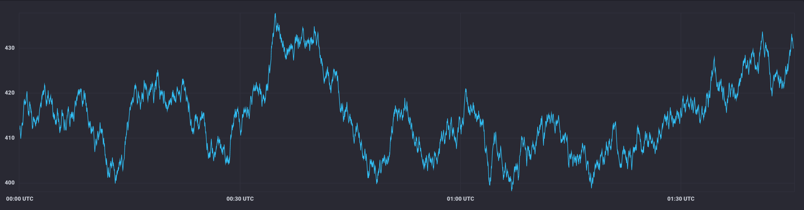
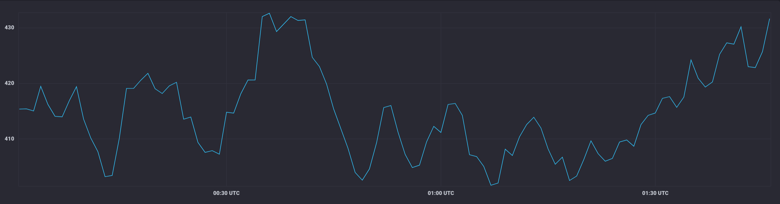
Typical use case: downsampling data
aggregateWindow(every: 1m, fn: mean)

Slide 61
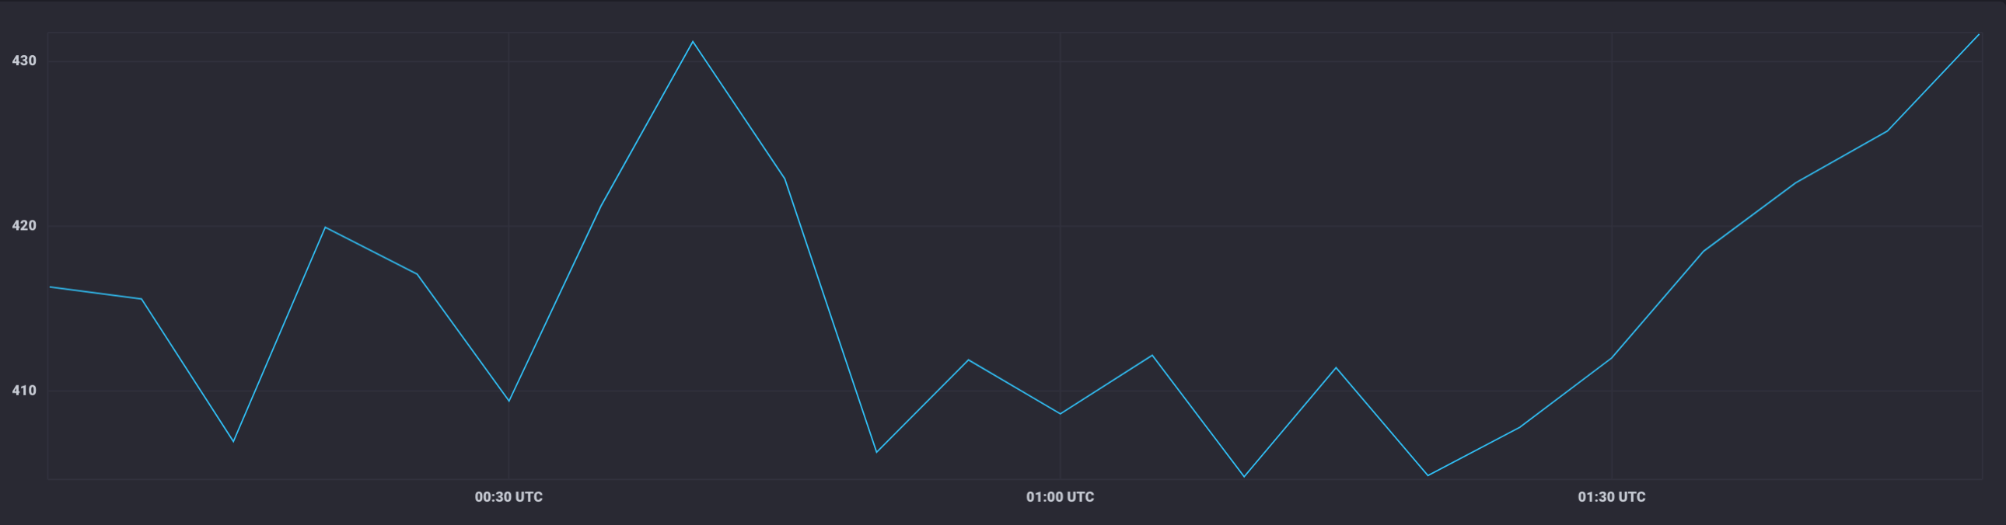
Typical use case: downsampling data (cont.)
aggregateWindow(every: 5m, fn: mean)

Slide 62
Let’s get dirty!
6

Slide 63
Continuous Linear Pizza Oven
Learning goals:
aggregateWindow
s2
s1

Slide 64
Task
Extract the moving average of the temperatures observed in the cooking base area over a window of 2 minutes
Extract the moving average of the temperatures observed by S2 over a window of 3 minutes

Slide 65
Quiz
True or false
you can omit the range clause – ?
filtering can change the number of tables in the result – ?
shaping always changes the number of tables in the result – ?
processing can change the number of tables in the result – ?
aggregateWindow function is just a process step – ?
aggregateWindow function eases the downsampling task – ?
the parameter createEmpty of the aggregateWindow function can change the number of tables in the result – ?

Slide 66
Quiz answer
True or false
you can omit the range clause – F
filtering can change the number of tables in the result – T (empty tables)
shaping always changes the number of tables in the result – F
processing can change the number of tables in the result – F
aggregateWindow function is just a process step – F
aggregateWindow function eases the downsampling task – T
the parameter createEmpty of the aggregateWindow function can change the number of tables in the result – T

Slide 67
Basic Data Analysis
Emanuele Della Valle Prof. @ Politecnico di Milano & Partner @ Quantia Consulting
Marco Balduini Founder & CEO @ Quantia Consulting
Riccardo Tommasini Prof. @ University of Tartu

